Slide 1

CUSTOMER CHURN ANALYSIS - DATABEL
By:
PREETHI REDDY MARAM

Slide 2
DATABEL
A Telecom Company.
BUSINESS PROBLEM:
Reducing the Customer Churn by analyzing the data.

Slide 3

Churn Rate:
Also known as Customer Churn.
It is defined as the rate at which the customers stop business with an entity.
Churn Rate = Number of churned customers/Total Number of customers

Slide 4
Why Dashboard?
Big Picture
To understand the churn patterns.
To define the key metrics.
To identify the pain points.
To analyze the given data.
To identify the reasons for customer churning.
To provide recommendations to reduce it.
Finally, to retain the customers.

Slide 5
Data Description
Customer Data table consisting of the customer details such as Customer ID, Churn Label, Churn Reason, Monthly Charges, Contract Type and so on.
No. of Rows = 6687
No. of Columns(fields) = 29
Total No of Customers = 6687
Total No of Churned Customers = 1796
Churn Rate = 26.86%

Slide 6
Fields/Variables Description
Some of the fields can be described as:
Customer ID – The unique ID used to identify a particular customer.
Churn Label – Maybe ‘Yes’ or ‘No’ which indicates the churn status of a customer.
Churn Reason – Provides reason for customer churn
Contract Type – Indicates the type of contract customer has with the Databel. I could be Month-to-month or One year or Two year.
Account Length – It indicates the number of months the customer is associated with the Databel.

Slide 7
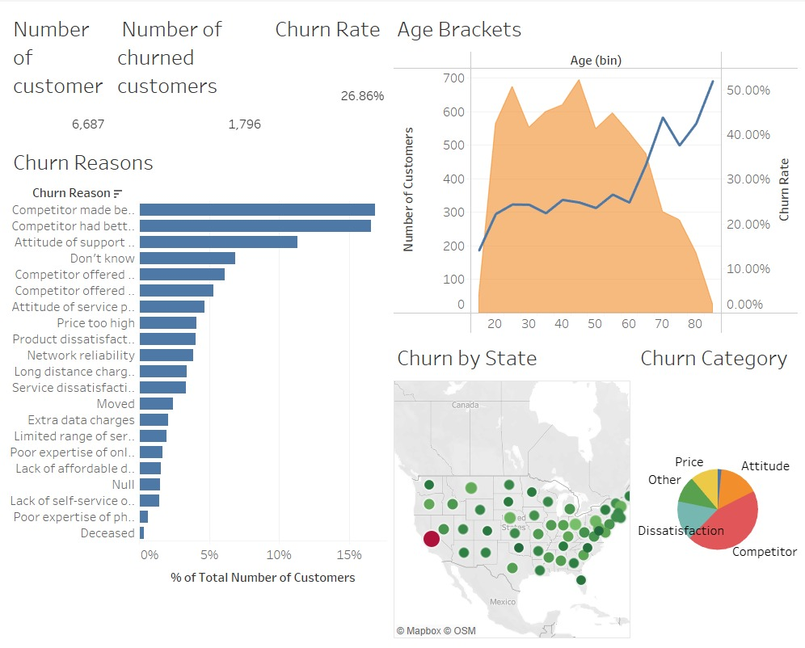
Overview Dashboard

Slide 8
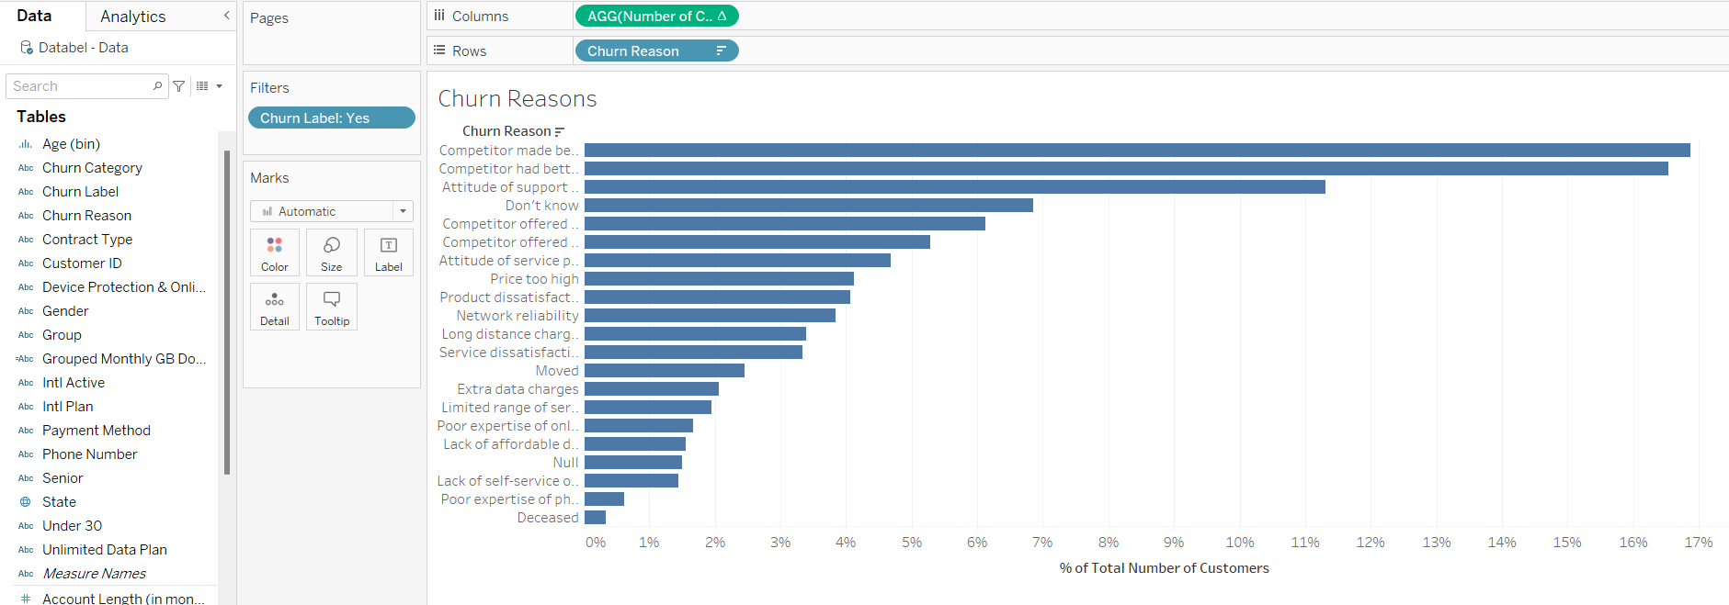
Churn Reasons Visualization

Slide 9
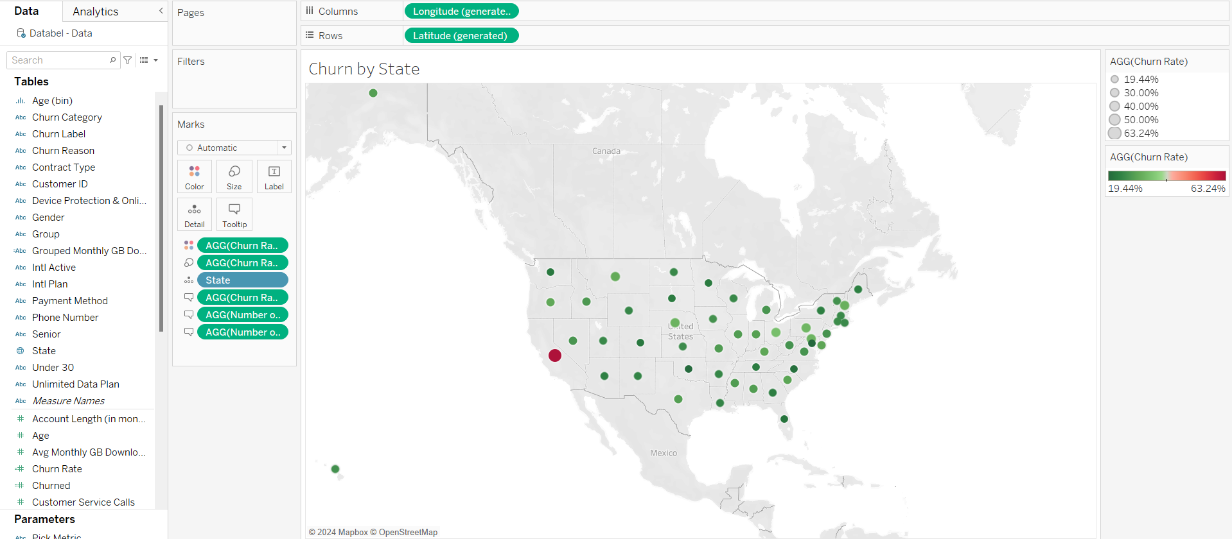
Churn by State

Slide 10
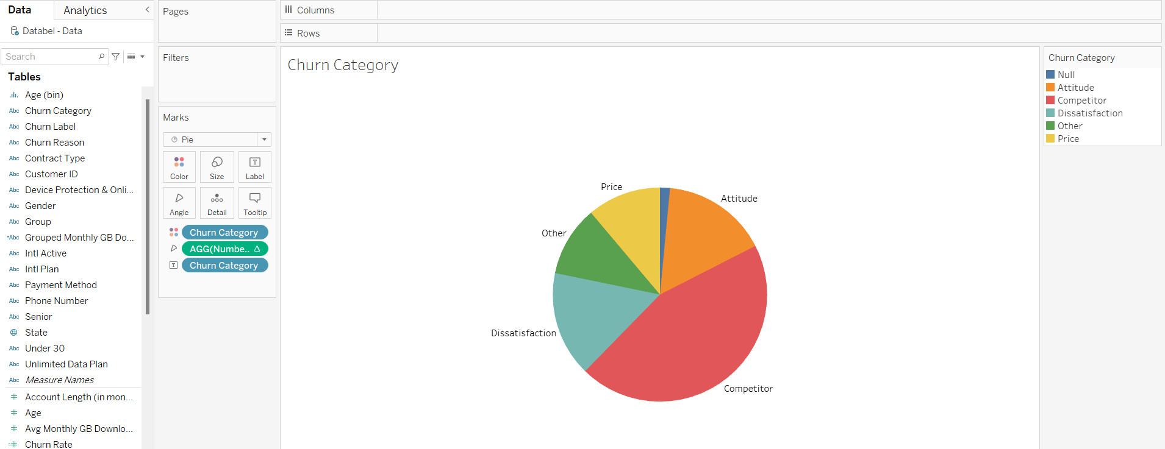
Churn by Category

Slide 11
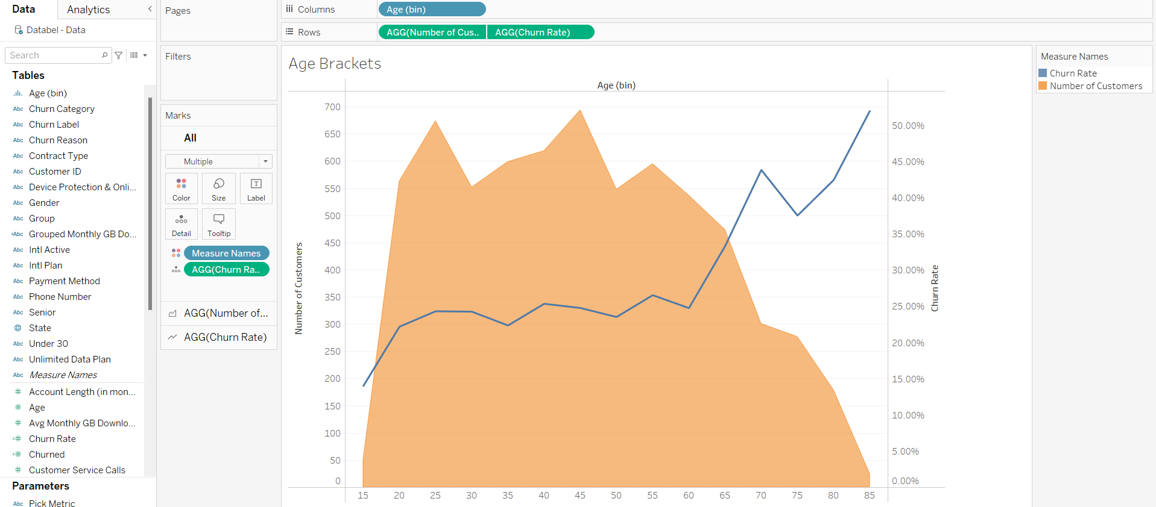
Churn by Age Bins

Slide 12
Conclusion
Concentrate on the state California
Concentrate on giving more offers than our competitors
Concentrate on the Age group which has high churn rate

Slide 13

Thank You

